Slide 1
Job Interview Presentation
Does Education Impact Hardship?
By David-Praise Ebiringa
December, 2023

Slide 2
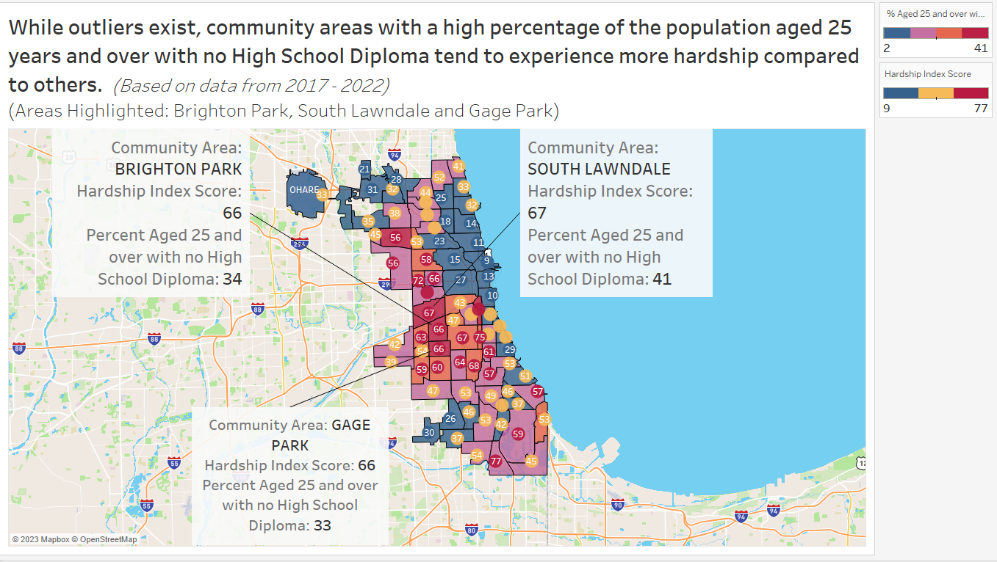
*The unemployment rate is stratified into three ranges by color:
Green – Low
Yellow – Middle
Red - High
* The sizes of the bubble plots indicate the arrest percentages.

Slide 3
Insights/Recommendation
The map shows the community areas in Chicago colorized by the percentage of persons aged 25 years and older without a High School diploma in each specific area along with the respective hardship index score (in circles) for that location.
The aim is to determine if community areas that have more people aged 25 years and above with no High School degree will be more likely to have higher hardship index scores.
The hardship index score is a composite score reflecting hardship in the community. Higher Values indicate greater hardship. Highlighted on the map are three locations that have a high percentage of people aged 25 or older, without a High School diploma as well as high values as their hardship index scores.
Although outliers exist, locations that have high illiteracy rates among their adults tend to have higher hardship index scores. This suggests that education is one of the significant factors that contribute to the hardship index score.
Some possible explanations as to why this is the case may include: conditions like the lack of qualified teachers, inadequate teaching materials, or in some cases the lack of high schools in these communities. Also, people who come from low-income families tend to prioritize making money to earn a living and support their families, over getting an education.
With this new information, the Mozilla Foundation can then design policy interventions geared toward providing people with access to education starting with the areas where the number of High School graduates is very low.
My recommendation is that the funds obtained from grants be used to implement projects that can support adult learning in these communities. In addition, resources should go into establishing high schools in community areas that don’t have enough and staffing them with highly qualified teachers who are motivated to make an impact in these communities. Lastly, weekly to monthly workshops where adults can be taught vocational skills can help them generate income for themselves to avoid being under extreme financial pressures so that they can focus on their education.

